Slide 1
Robot framework

Slide 2
Robot framework
Robot framework is the generic test automation framework.
It has easy-to-use tabular test data syntax.
It utilizes the keyword-driven testing approach.
Its testing capabilities can be extended by test libraries.
User can create new higher level keywords from existing ones using the same syntax.
It is operating system and application independent .the core framework is implemented using python.
Robot framework is open source.

Slide 3
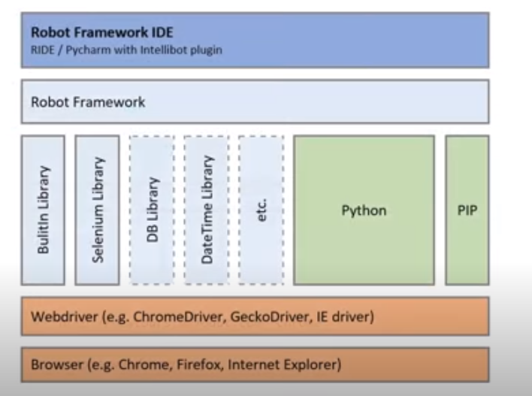
Robot framework Architecture and test flow

Slide 4
Robot framework installation
Step 1 – Install python
through python.org , download and install python
Step 2 - install Robot framework and selenuim
Pip install robotframework using cmd
pip install robotframework-seleniumLibaray.
Step 3 –Verify the installation
Robot –version
  Step -4 -install ide
  download and install PyCharm ide

Slide 5
Locators
1)Name
2)Id
3)Class
5)link
6)X path
7)css selector

Slide 6
Keywords
Robot framework comes with built-in keywords available with robot framework, keywords available from the libraries like Selenium Library (open browser, close browser, maximize browser, etc.). We can also create user-defined keywords, which are a combination of other user-defined keywords or built-in or library keywords. We can also pass arguments to those keywords, which make the user-defined keywords like functions that can be reused.

Slide 7
Variables
Robot framework supports variables – scalar, list and dict. Variables in robot framework are easy to use and are of great help while writing complex test cases.

Slide 8
Libraries
Robot framework has support for a lot of external libraries like SeleniumLibrary, Database Library, FTP Library and http library. SeleniumLibrary is mostly used as it helps to interact with the browsers and helps with web application and UI testing. Robot framework also has its own built-in libraries for strings, date, numbers etc.

Slide 9
Reports and Logs
Robot framework provides all the details of test suite, test case execution in the form of report and logs. All the execution details of the test case are available in the log file. The details like whether the test case has failed or passed, time taken for execution, steps followed to run the test case are provided.

Slide 10
Robot Framework Advantages
It is very easy to install and helps in creating and executing test cases. Any new comer can easily understand and does not need any high level knowledge of testing to get started with robot framework.
It supports keyword-driven, behaviour-driven and data-driven style of writing test cases.
It is a good support for external libraries. Most used is Selenium Library, which is easy to install and use in robot framework.

Slide 11
Robot Framework Limitations
Robot lacks support for if-else, nested loops, which are required when the code gets complex.

